Slide 1
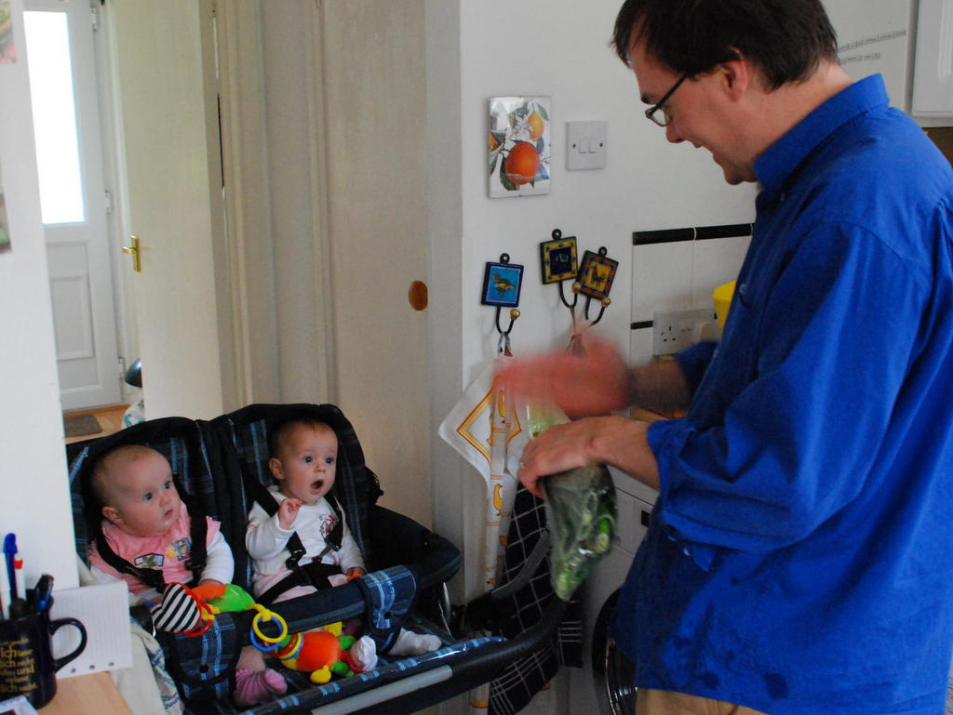
Mindreading
& Joint Action
6. Goal Ascription
butterfillS@ceu.hu
butterfillS@ceu.hu

Slide 2
How could pure goal ascription work?

Slide 3
How could pure goal ascription work?

Slide 4
How could pure goal ascription work?

Slide 5
sophisticated theory of mind cognition
communication by language
(mis)understanding ostensive communication
understanding distributive goals
understanding goals

Slide 6
Mindreading is acting in reverse

Slide 7
change nappy
plans
prepare infant
prepare nappy
assemble

Slide 8
change nappy
plans
prepare infant
prepare nappy
assemble
goals
strip clothes
clean bum
open
place under
close studs

Slide 9
change nappy
plans
prepare infant
prepare nappy
assemble
goals
strip clothes
clean bum
open
place under
close studs
… /reach X/ /grasp X/ /grasp Y/ /pull Y/ /scoop X/ /Y out of X/ …
motor action

Slide 10
change nappy
plans
prepare infant
prepare nappy
assemble
goals
strip clothes
clean bum
open
place under
close studs
… /reach X/ /grasp X/ /grasp Y/ /pull Y/ /scoop X/ /Y out of X/ …
motor action
… [reach-left-hand X] [left-wholehand-grasp X] [right-wholehand-grasp …

Slide 11

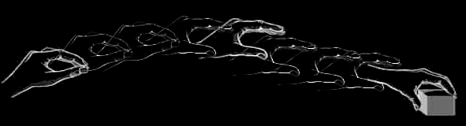
change nappy
plans
prepare infant
prepare nappy
assemble
goals
strip clothes
clean bum
open
place under
close studs
… /reach X/ /grasp X/ /grasp Y/ /pull Y/ /scoop X/ /Y out of X/ …
motor action
… [reach-left-hand X] [left-wholehand-grasp X] [right-wholehand-grasp …
motion
Image adapted from: Rizzolatti, Giacomo, and Giuseppe Luppino. 2001. The Cortical Motor System. Neuron 31, no. 6 (September 27): 889-901. doi:10.1016/S0896-6273(01)00423-8.

Slide 12
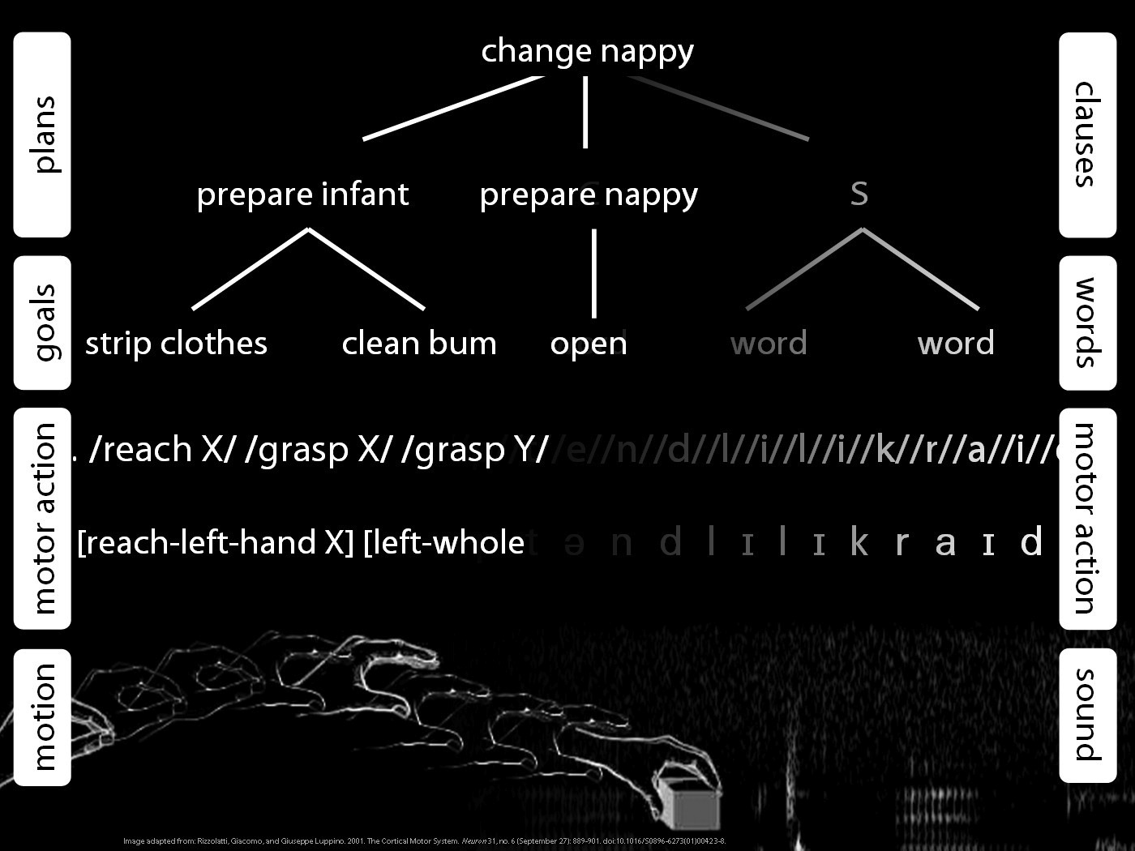

Slide 13
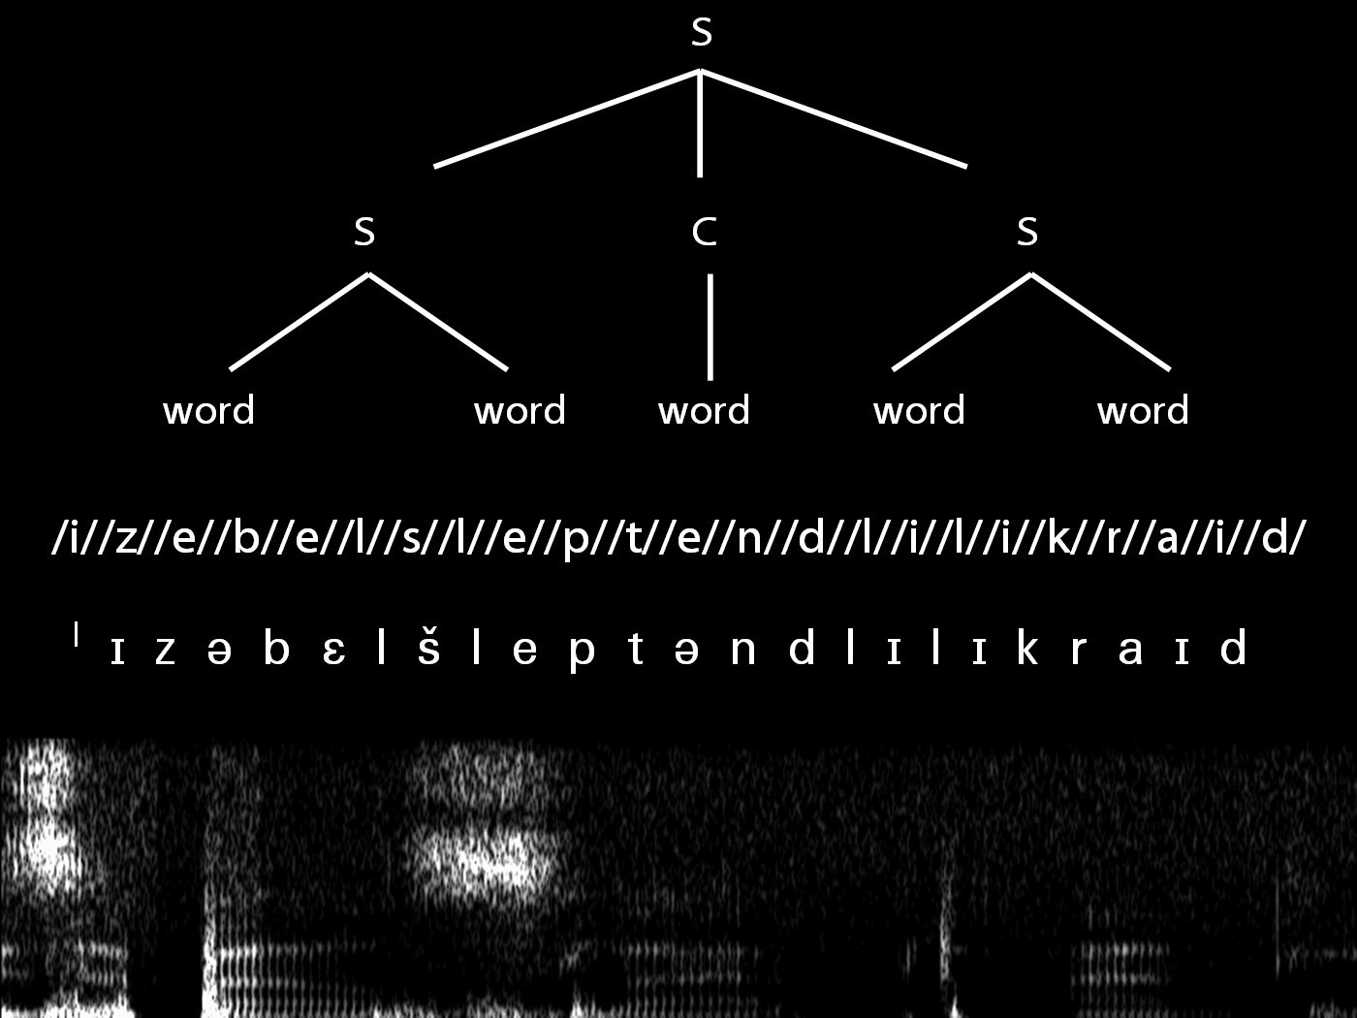

Slide 15
change nappy
plans
prepare infant
prepare nappy
assemble
goals
strip clothes
clean bum
open
place under
close studs
… /reach X/ /grasp X/ /grasp Y/ /pull Y/ /scoop X/ /Y out of X/ …
motor action
… [reach-left-hand X] [left-wholehand-grasp X] [right-wholehand-grasp …
motion
Image adapted from: Rizzolatti, Giacomo, and Giuseppe Luppino. 2001. The Cortical Motor System. Neuron 31, no. 6 (September 27): 889-901. doi:10.1016/S0896-6273(01)00423-8.

Slide 16
How could pure goal ascription work?

Slide 17
How could pure goal ascription work?
obstacle

Slide 18
1. action
2. outcome
3. directedness of action to outcome

Slide 19
1. action
2. outcome
3. directedness of action to outcome

Slide 20
Ayesha
Beatrice
1. action
2. outcome
3. directedness of action to outcome
move arm
break egg
Y
move arm
break egg
N

Slide 21
Ayesha
Beatrice
1. action
2. outcome
3. directedness of action to outcome
move arm
break egg
Y
move arm
break egg
N

Slide 22
1. action
2. outcome
3. directedness of action to outcome

Slide 23
What is the relation between an action and the outcome or outcomes to which it is directed?
out
action
out
out
act
out
out
Notes:
So among all the actual and possible outcomes of my action, one or some are singled out as specially related to this action.
One aspect of the question concerns what singles out the outcome or outcomes, actual or merely possible, to which a particular purposive is directed.
But there is also a second aspect ...

Slide 24
What is the relation between an action and the outcome or outcomes to which it is directed?
out
action
out
act
out
intention or motor representation
out
Notes:
The standard answer to this question involves intention.
An intention (1) represents an outcome, (2) coordinates the one or several activities which comprise the action; and (3) coordinate these activities in a way that would normally facilitate the outcome’s occurrence.
What binds particular component actions together into larger purposive actions? It is the fact that these actions are all parts of plans involving a single intention.
What singles out an actual or possible outcome as one to which the component actions are collectively directed? It is the fact that this outcome is represented by the intention.
So the intention is what binds component actions together into purposive actions and links the action taken as a whole to the outcomes to which they are directed.
On this picture there is no distinctive role for motor representation in explaining what action is.
It can allow, of course, that in some agents motor representation is involved in performing actions.
But this is treated as having no bearing at all on our question about the relation between actions and the outcomes to which they are directed.
Motor representation is at most an enabling condition for action and has no relevance to understanding what action is.
This view might be acceptable if all motor representations represented only kinematic or dynamic features of actions mere joint displacements or muscle contractions. However, we shall argue that some motor representations represent action outcomes such as grasping, tearing or throwing. Furthermore, as we shall go on to argue, such representations ground purposive actions.

Slide 25
What is the relation between an action and the outcome or outcomes to which it is directed?
teleological function
out
action
out
act
out
intention or motor representation
out
Notes:
The standard answer to this question involves intention.
An intention (1) represents an outcome, (2) coordinates the one or several activities which comprise the action; and (3) coordinate these activities in a way that would normally facilitate the outcome’s occurrence.
What binds particular component actions together into larger purposive actions? It is the fact that these actions are all parts of plans involving a single intention.
What singles out an actual or possible outcome as one to which the component actions are collectively directed? It is the fact that this outcome is represented by the intention.
So the intention is what binds component actions together into purposive actions and links the action taken as a whole to the outcomes to which they are directed.
On this picture there is no distinctive role for motor representation in explaining what action is.
It can allow, of course, that in some agents motor representation is involved in performing actions.
But this is treated as having no bearing at all on our question about the relation between actions and the outcomes to which they are directed.
Motor representation is at most an enabling condition for action and has no relevance to understanding what action is.
This view might be acceptable if all motor representations represented only kinematic or dynamic features of actions mere joint displacements or muscle contractions. However, we shall argue that some motor representations represent action outcomes such as grasping, tearing or throwing. Furthermore, as we shall go on to argue, such representations ground purposive actions.

Slide 26
(i) in the past, actions of this type have caused outcomes of this type; (ii) this action happens now in part because (i).
What is the relation between an action and the outcome or outcomes to which it is directed?
teleological function
out
action
out
act
out
intention or motor representation
out
Notes:
The standard answer to this question involves intention.
An intention (1) represents an outcome, (2) coordinates the one or several activities which comprise the action; and (3) coordinate these activities in a way that would normally facilitate the outcome’s occurrence.
What binds particular component actions together into larger purposive actions? It is the fact that these actions are all parts of plans involving a single intention.
What singles out an actual or possible outcome as one to which the component actions are collectively directed? It is the fact that this outcome is represented by the intention.
So the intention is what binds component actions together into purposive actions and links the action taken as a whole to the outcomes to which they are directed.
On this picture there is no distinctive role for motor representation in explaining what action is.
It can allow, of course, that in some agents motor representation is involved in performing actions.
But this is treated as having no bearing at all on our question about the relation between actions and the outcomes to which they are directed.
Motor representation is at most an enabling condition for action and has no relevance to understanding what action is.
This view might be acceptable if all motor representations represented only kinematic or dynamic features of actions mere joint displacements or muscle contractions. However, we shall argue that some motor representations represent action outcomes such as grasping, tearing or throwing. Furthermore, as we shall go on to argue, such representations ground purposive actions.

Slide 27
(i) in the past, actions of this type have caused outcomes of this type; (ii) this action happens now in part because (i).
What is the relation between an action and the outcome or outcomes to which it is directed?
teleological function
out
action
out
act
out
intention or motor representation
It is possible to represent goal-directed actions without representing intentions.
out
Notes:
The standard answer to this question involves intention.
An intention (1) represents an outcome, (2) coordinates the one or several activities which comprise the action; and (3) coordinate these activities in a way that would normally facilitate the outcome’s occurrence.
What binds particular component actions together into larger purposive actions? It is the fact that these actions are all parts of plans involving a single intention.
What singles out an actual or possible outcome as one to which the component actions are collectively directed? It is the fact that this outcome is represented by the intention.
So the intention is what binds component actions together into purposive actions and links the action taken as a whole to the outcomes to which they are directed.
On this picture there is no distinctive role for motor representation in explaining what action is.
It can allow, of course, that in some agents motor representation is involved in performing actions.
But this is treated as having no bearing at all on our question about the relation between actions and the outcomes to which they are directed.
Motor representation is at most an enabling condition for action and has no relevance to understanding what action is.
This view might be acceptable if all motor representations represented only kinematic or dynamic features of actions mere joint displacements or muscle contractions. However, we shall argue that some motor representations represent action outcomes such as grasping, tearing or throwing. Furthermore, as we shall go on to argue, such representations ground purposive actions.

Slide 28
How could pure goal ascription work?
obstacle

Slide 29
‘the perceptual origins of theory of mind ... both causality and intention can be traced to perceptual origins’
(Premack 1990: 15)
‘in perceiving one object as having the intention of affecting another, the infant attributes to the object a representation of its intentions’
(Premack 1990: 14)
‘For the infant, objects ... have intention when their movements are self-propelled. Whereas for common sense, intention is an inferred state of mind based on evidence for desire, belief, and planning.’
(Premack 1990: 12)

Slide 30


‘the perceptual origins of theory of mind ... both causality and intention can be traced to perceptual origins’
(Premack 1990: 15)
‘in perceiving one object as having the intention of affecting another, the infant attributes to the object a representation of its intentions’
(Premack 1990: 14)
“chimpanzees understand … intentions … perception and knowledge … Moreover, they understand how these psychological states work together to produce intentional action”
(Call & Tomasello 2008:191)

Slide 31
How could pure goal ascription work?

Slide 32
(1) reliably: R(a,G) when and only when a is directed to G
(2) R(a,G) is readily detectable
(3) R(a,G) is readily detectable without any knowledge of mental states

Slide 33
(1) reliably: R(a,G) when and only when a is directed to G
(2) R(a,G) is readily detectable
(3) R(a,G) is readily detectable without any knowledge of mental states
R(a,G) =_{df} G is the teleological function of a?

Slide 34
(1) reliably: R(a,G) when and only when a is directed to G
(2) R(a,G) is readily detectable
(3) R(a,G) is readily detectable without any knowledge of mental states
R(a,G) =_{df} a causes G?

Slide 35
(1) reliably: R(a,G) when and only when a is directed to G
(2) R(a,G) is readily detectable
(3) R(a,G) is readily detectable without any knowledge of mental states
R(a,G) =_{df} a causes G?

Slide 36
(1) reliably: R(a,G) when and only when a is directed to G
(2) R(a,G) is readily detectable
(3) R(a,G) is readily detectable without any knowledge of mental states
R(a,G) =_{df} a causes G?

Slide 37
(1) reliably: R(a,G) when and only when a is directed to G
(2) R(a,G) is readily detectable
(3) R(a,G) is readily detectable without any knowledge of mental states
R(a,G) =_{df} ???a is the most justifiable action towards G available within the constraints of reality

Slide 38
(1) reliably: R(a,G) when and only when a is directed to G
(2) R(a,G) is readily detectable
(3) R(a,G) is readily detectable without any knowledge of mental states
R(a,G) =_{df} ???a is the most justifiable action towards G available within the constraints of reality
‘an action can be explained by a goal state if, and only if, it is seen as the most justifiable action towards that goal state that is available within the constraints of reality’
(Csibra & Gergely 1998: 255)

Slide 39
(1) reliably: R(a,G) when and only when a is directed to G
(2) R(a,G) is readily detectable
(3) R(a,G) is readily detectable without any knowledge of mental states
R(a,G) =_{df} a is the most justifiable action towards G available within the constraints of reality
‘an action can be explained by a goal state if, and only if, it is seen as the most justifiable action towards that goal state that is available within the constraints of reality’
(Csibra & Gergely 1998: 255)

Slide 40
(1) reliably: R(a,G) when and only when a is directed to G
(2) R(a,G) is readily detectable
(3) R(a,G) is readily detectable without any knowledge of mental states
R(a,G) =_{df} a is the most justifiable action towards G available within the constraints of reality
‘an observed behaviour is interpreted as an action directed to a particular end state if it is judged to be the most efficient means available to the agent for achieving this goal in the given environment.’
(Csibra & Gergely forthcoming: 2)

Slide 41
(1) reliably: R(a,G) when and only when a is directed to G
(2) R(a,G) is readily detectable
(3) R(a,G) is readily detectable without any knowledge of mental states
R(a,G) =_{df} a is the most justifiable/efficient action towards G available within the constraints of reality
‘an observed behaviour is interpreted as an action directed to a particular end state if it is judged to be the most efficient means available to the agent for achieving this goal in the given environment.’
(Csibra & Gergely forthcoming: 2)

Slide 42
(1) reliably: R(a,G) when and only when a is directed to G
(2) R(a,G) is readily detectable
(3) R(a,G) is readily detectable without any knowledge of mental states
R(a,G) =_{df} a is the most justifiable/efficient action towards G available within the constraints of reality
‘an observed behaviour is interpreted as an action directed to a particular end state if it is judged to be the most efficient means available to the agent for achieving this goal in the given environment.’
(Csibra & Gergely forthcoming: 2)

Slide 43
(1) reliably: R(a,G) when and only when a is directed to G
(2) R(a,G) is readily detectable
(3) R(a,G) is readily detectable without any knowledge of mental states
R(a,G) =_{df} a is the most justifiable/efficient action towards G available within the constraints of reality
‘an observed behaviour is interpreted as an action directed to a particular end state if it is judged to be the most efficient means available to the agent for achieving this goal in the given environment.’
(Csibra & Gergely forthcoming: 2)

Slide 44
(1) reliably: R(a,G) when and only when a is directed to G
(2) R(a,G) is readily detectable
(3) R(a,G) is readily detectable without any knowledge of mental states
R(a,G) =_{df} a is the most justifiable/efficient action towards G available within the constraints of reality and G is desirable

Slide 45
(1) reliably: R(a,G) when and only when a is directed to G
(2) R(a,G) is readily detectable
(3) R(a,G) is readily detectable without any knowledge of mental states
R(a,G) =_{df} a is the most justifiable/efficient action towards G available within the constraints of reality and G is desirable

Slide 46
(1) reliably: R(a,G) when and only when a is directed to G
(2) R(a,G) is readily detectable
(3) R(a,G) is readily detectable without any knowledge of mental states
R(a,G) =_{df} a is the most justifiable/efficient action towards G available within the constraints of reality and G is desirable

Slide 47
`Such calculations require detailed knowledge of biomechanical factors

Slide 48
`Such calculations require detailed knowledge of biomechanical factors that determine the motion capabilities and energy expenditure of agents. However, in the absence of such knowledge, one can appeal to heuristics that approximate the results of these calculations on the basis of knowledge in other domains that is certainly available to young infants. For example, the length of pathways can be assessed by geometrical calculations, taking also into account some physical factors (like the impenetrability of solid objects). Similarly, the fewer steps an action sequence takes, the less effort it might require, and so infants' numerical competence can also contribute to efficiency evaluation. ‘
Csibra & Gergely (forthcoming ms p. 8)

Slide 49
`Such calculations require detailed knowledge of biomechanical factors

Slide 50
(1) reliably: R(a,G) when and only when a is directed to G
(2) R(a,G) is readily detectable
(3) R(a,G) is readily detectable without any knowledge of mental states
R(a,G) =_{df} a is the most justifiable/efficient action towards G available within the constraints of reality and G is desirable

Slide 51

Motor Planning

Slide 52
Motor planning occurs in action observation

Slide 53
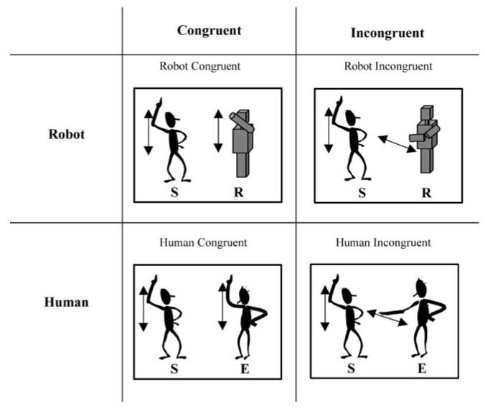
source Kilner et al (2003)

Slide 54
source Kilner et al (2003)

Slide 55
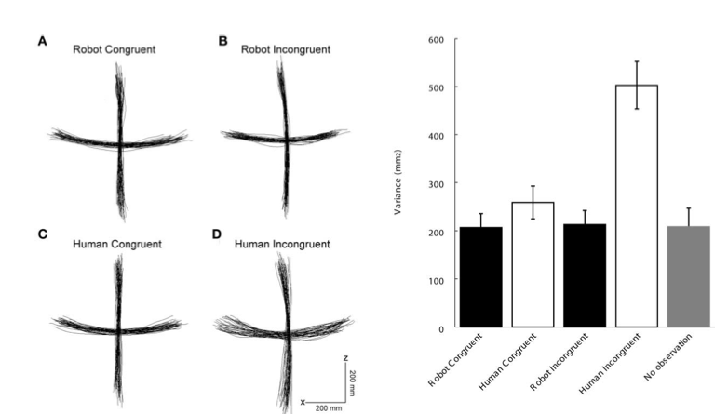
source Kilner et al (2003)

Slide 56
source Kilner et al (2003)

Slide 57
source Kilner et al (2003)

Slide 58
source Kilner et al (2003)

Slide 59
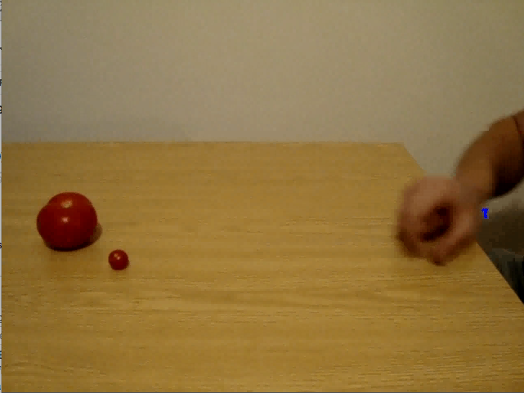
source Costantini,Ambrosini,Cardellicchio & Sinigaglia (2012)

Slide 60
Motor planning can facilitate goal judgments

Slide 61

Motor planning can facilitate goal judgments
Training effects (Casile & Giese 2006)
TMS to motor cortex slows goal judgments (Urgesi et al 2007)
Hemiplegia with inaccuracy in corresponding goal judgments (Serino et al 2009)
Limb vs buccofacial apraxia (Pazzaglia)

Slide 62
Planning as Goal Ascription

Slide 63
(1) reliably: R(a,G) when and only when a is directed to G
(2) R(a,G) is readily detectable
(3) R(a,G) is readily detectable without any knowledge of mental states
R(a,G) =_{df} a is the most justifiable/efficient action towards G available within the constraints of reality and G is desirable
R_{M}(a,G) =_{df} if planning mechanism M were tasked with producing outcome G it would plan action a.

Slide 64
(1) reliably: R(a,G) when and only when a is directed to G
(2) R(a,G) is readily detectable
(3) R(a,G) is readily detectable without any knowledge of mental states
R(a,G) =_{df} a is the most justifiable/efficient action towards G available within the constraints of reality and G is desirable
R_{M}(a,G) =_{df} if planning mechanism M were tasked with producing outcome G it would plan action a.

Slide 65
(1) reliably: R(a,G) when and only when a is directed to G
(2) R(a,G) is readily detectable
(3) R(a,G) is readily detectable without any knowledge of mental states
R(a,G) =_{df} a is the most justifiable/efficient action towards G available within the constraints of reality and G is desirable
R_{M}(a,G) =_{df} if planning mechanism M were tasked with producing outcome G it would plan action a.

Slide 66
(1) reliably: R(a,G) when and only when a is directed to G
(2) R(a,G) is readily detectable
(3) R(a,G) is readily detectable without any knowledge of mental states
R(a,G) =_{df} a is the most justifiable/efficient action towards G available within the constraints of reality and G is desirable
R_{M}(a,G) =_{df} if planning mechanism M were tasked with producing outcome G it would plan action a.

Slide 68
(1) reliably: R(a,G) when and only when a is directed to G
(2) R(a,G) is readily detectable
(3) R(a,G) is readily detectable without any knowledge of mental states
R(a,G) =_{df} ???
‘goal attribution requires that agents expend the least possible amount of energy within their motor constraints to achieve a certain end’
(Southgate et al, 2008: 1061)

Slide 69
(1) reliably: R(a,G) when and only when a is directed to G
(2) R(a,G) is readily detectable
(3) R(a,G) is readily detectable without any knowledge of mental states
R(a,G) =_{df} a is the most justifiable action towards G available within the constraints of reality
‘an action can be explained by a goal state if, and only if, it is seen as the most justifiable action towards that goal state that is available within the constraints of reality’
(Csibra & Gergely 1998: 255)

Slide 70
Some motor representations carry information about outcomes.
Notes:
so why do we think this? the first step is to show that some motor representations carry information about outcomes. How do we show this?

Slide 71
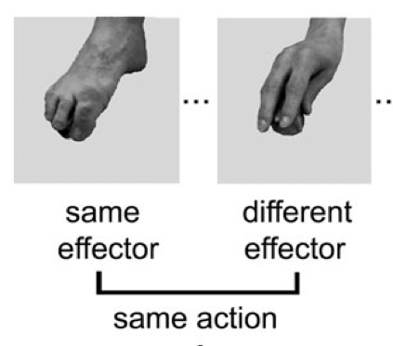
Some motor representations carry information about outcomes.
same outcome
Cattaneo et al (2010)
Notes:
vary kinematic and dynamic features but keep outcome constant.

Slide 72
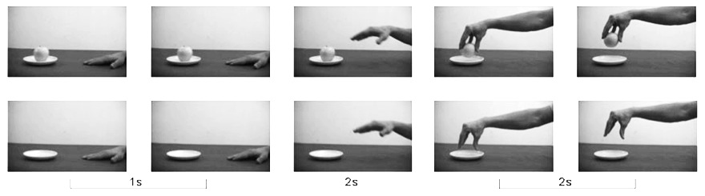
Some motor representations carry information about outcomes.
same outcome
Cattaneo et al (2010)
Villiger et al (2010)
Notes:
keep kinematic and dynamic features constant but vary outcome. There are several ways to do that; one is simply to compare an ordinary grasping action with the same movements performed in the absence of the target object.

Slide 73
Some motor representations carry information about outcomes.
same outcome
Cattaneo et al (2010)
Villiger et al (2010)

Slide 74
Some motor representations carry information about outcomes.
Information about outcomes guides planning.

Slide 75
Some motor representations carry information about outcomes.
Information about outcomes guides planning.
hand-1
reach
grasp
move
arrive
release
hand-2
reach
grasp
move
place
release

Slide 76
Some motor representations carry information about outcomes.
Information about outcomes guides planning.
get it
move it
position it
hand-1
reach
grasp
move
arrive
release
hand-2
reach
grasp
move
place
release

Slide 77
Some motor representations carry information about outcomes.
Information about outcomes guides planning.
Move it from there to here
get it
move it
position it
hand-1
reach
grasp
move
arrive
release
hand-2
reach
grasp
move
place
release

Slide 78
Some motor representations carry information about outcomes.
Information about outcomes guides planning.
Move it from there to here
get it
move it
position it
hand-1
reach
grasp
move
arrive
release
hand-2
reach
grasp
move
place
release

Slide 79
Some motor representations carry information about outcomes.
Information about outcomes guides planning.
Some motor representations represent outcomes
Move it from there to here
get it
move it
position it
hand-1
reach
grasp
move
arrive
release
hand-2
reach
grasp
move
place
release

Slide 80
What is the relation between a purposive action and the outcome or outcomes to which it is directed?
out
action
out
act
out
intention or motor representation
out

Slide 81
What is the relation between a purposive action and the outcome or outcomes to which it is directed?
out
action
out
act
out
intention or motor representation
out
Notes:
Now as Elisabeth Pacherie has argued (and I’ve had a go at arguing this in joint work with Corrado Sinigaglia recently too),
motor representations are relevantly similar to intentions.
Of course motor representations differ from intentions in some important ways (as Pacherie also notes).
But they are similar in the respects that matter for explaining the purposiveness of action.
(1) Like intentions, some motor representations represent outcomes (and not merely patters of joint displacement, say).
(2) Like intentions, some motor representations play a role in coordinating multiple more component activities by virtue of their role as elements in hierarchically structured plans.
(3) And, like intentions, some motor representations coordinate these activities in a way that would normally facilitate the outcome’s occurrence.
The claim is not that \emph{all} purposive actions are linked to outcomes by motor representations, just that some are.
In some cases, the purposiveness of an action is grounded in a motor representation of an outcome; in other cases it is grounded in an intention.
And of course in many cases it may be that both intention and motor representation are involved.

Slide 82
motor representation = intention ? No !

Slide 83
motor representation = intention ? No !

Slide 84
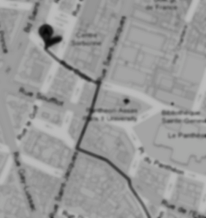
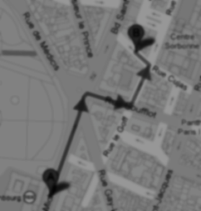
< different content >
Notes:
As background we first need a generic distinction between content and format. Imagine you are in an unfamiliar city and are trying to get to the central station. A stranger offers you two routes. Each route could be represented by a distinct line on a paper map. The difference between the two lines is a difference in content. Each of the routes could alternatively have been represented by a distinct series of instructions written on the same piece of paper; these cartographic and propositional representations differ in format. The format of a representation constrains its possible contents. For example, a representation with a cartographic format cannot represent what is represented by sentences such as `There could not be a mountain whose summit is inaccessible.'\footnote{ Note that the distinction between content and format is orthogonal to issues about representational medium. The maps in our illustration may be paper map or electronic maps, and the instructions may be spoken, signed or written. This difference is one of medium.} The distinction between content and format is necessary because, as our illustration shows, each can be varied independently of the other.

Slide 85
< different content >
Head down Rue Cujas toward Rue Victor Cousin. Turn right onto Rue Saint-Jacques. ...
Take RER B and get out at the Luxembourg station, from there it's less than 5 minutes walk.
< different format >
Notes:
As background we first need a generic distinction between content and format. Imagine you are in an unfamiliar city and are trying to get to the central station. A stranger offers you two routes. Each route could be represented by a distinct line on a paper map. The difference between the two lines is a difference in content. Each of the routes could alternatively have been represented by a distinct series of instructions written on the same piece of paper; these cartographic and propositional representations differ in format. The format of a representation constrains its possible contents. For example, a representation with a cartographic format cannot represent what is represented by sentences such as `There could not be a mountain whose summit is inaccessible.'\footnote{ Note that the distinction between content and format is orthogonal to issues about representational medium. The maps in our illustration may be paper map or electronic maps, and the instructions may be spoken, signed or written. This difference is one of medium.}

Slide 86
Head down Rue Cujas toward Rue Victor Cousin. Turn right onto Rue Saint-Jacques. ...
=
?
Notes:
Format matters because only where two representations have the same format can they be straightforwardly inferentially integrated.
To illustrate, let’s stay with representations of routes.
Suppose you are given some verbal instructions describing a route. You are then shown a representation of a route on a map and asked whether this is the same route that was verbally described. You are not allowed to find out by following the routes or by imagining following them.
Special cases aside, answering the question will involve a process of translation because two distinct representational formats are involved, propositional and cartographic. It is not be enough that you could follow either representation of the route. You will also need to be able to translate from at least one representational format into at least one other format.

Slide 87
Head down Rue Cujas toward Rue Victor Cousin. Turn right onto Rue Saint-Jacques. ...
e.g. rapid identification of key landmarks; slow translation into compass directions
< different format >
Rapid identification of direction of start from end (projection-dependent)
< different performance>
Notes:
How in general can we identify or distinguish representational formats? Because representational formats are typically associated with characteristic performance profiles, it is sometimes possible to infer similarities and differences in representational format from similarities and differences in the processes in which representations feature.
To illustrate, suppose that you have a route representation and I want to work out whether it this representation has a cartographic or propositional format. One way to do this might be to test your performance on different tasks. If the representation is propositional you are likely to be relatively fast at identifying key landmarks but relatively slow at translating the route into a sequence of compass directions; but the converse will be true if your representation is cartographic.

Slide 88
imagine
seeing
Notes:
The same principle---distinguishing and identifying formats by measuring characteristic processing profile---works for mental representations too.
To illustrate, compare imagining seeing an object moving with actually seeing it move. For this comparison we need to distinguish two ways of imagining seeing. There is a way of imagining seeing which phenomenologically is something like seeing except that it does not necessarily involve being receptive to stimuli. This way of imagining seeing, sometimes called `sensory imagining', is commonly distinguished from cognitive ways of imagining seeing which might for example involve thinking about seeing.
It is this way of imagining seeing an object move that we wish to compare with actually seeing an object move.

Slide 89
imagine
actually
seeing
seeing
1
Notes:
Imagining seeing an object move and actually seeing an object move have similarities in characteristic performance profile. For instance, whether an object can be seen all at once depends on its size and distance from the perceiver; strikingly, when subjects imagine seeing an object, whether they can imagine seeing it all at once depends in the same way on size and distance (\citealp{kosslyn:1978_measuring}; \citealp[p.\ 99ff]{kosslyn:1994_image}).
Also, how long it takes to imagine looking over an object depends on the object's subjective size in the same way that how long it would take to actually look over that object would depend on its subjective size \citep{kosslyn:1978_visual}.
The similarities in characteristic performance profile and the particular patterns of interference are good (if non-decisive) reasons to conjecture that imagining seeing and actually seeing involve representations with a common format.

Slide 90
imagine
actually
seeing
acting
seeing
acting
1
2
Notes:
One way of imagining action is phenomenologically something like acting except that such imaginings are not necessarily responsive to the features of actual objects and do not necessarily result in bodily movements.
There is evidence that the way imagining performing an action unfolds in time is similar in some respects to the way actually performing an action of the same type would unfold.
For instance, how long it takes to imagine moving an object is closely related to how long it would take to actually move that object \citep{decety:1989_timing, decety:1996_imagined, Jeannerod:1994oz}.
In addition, for actions such as grasping the handle of a cup, manipulating the target object in ways that would make the action harder (such as orienting the cup's handle to make it less convenient for you to grasp) make a corresponding difference to the effort involved in imagining performing the action \citep{parsons:1994_temporal, frak:2001_orientation}.

Slide 91
imagine
actually
3
seeing
acting
seeing
acting
1
2
Notes:
Contrast imagining rotating a ball with imagining seeing a ball rotate.
As is implied by what we’ve already said, these have quite different characteristic performance profiles.
How quickly the former can be done is a function of how long it would take the agent to rotate the ball, whereas how quickly the latter can be done depends on how rapidly the ball can rotate and still be perceived as rotating.
Further, in some cases rotating a ball clockwise is easier than rotating it anti-clockwise, and so is imagining a ball rotate. By contrast, the effort involved in actually seeing or imagining seeing a ball rotate does not similarly differ depending on direction.

Slide 92


imagine
actually
3
seeing
acting
seeing
acting
1
2
Fiori et al (submitted)

Slide 93
imagine
actually
3
seeing
acting
seeing
acting
1
2
imagine (cognitive)
4
acting

Slide 94
No motor representations are propositional attitudes.
Notes:
This brings me to the argument ...

Slide 95
Only representations with a common format can be inferentially integrated.
Any two intentions can be inferentially integrated in practical reasoning.
My intention that I visit Glasgow on Monday is a propositional attitude.
No motor representations are propositional attitudes.
Notes:
This brings me to the argument ...

Slide 96
Only representations with a common format can be inferentially integrated.
Any two intentions can be inferentially integrated in practical reasoning.
My intention that I visit Glasgow on Monday is a propositional attitude.
All intentions are propositional attitudes.
No motor representations are propositional attitudes.

Slide 97
Only representations with a common format can be inferentially integrated.
Any two intentions can be inferentially integrated in practical reasoning.
My intention that I visit Glasgow on Monday is a propositional attitude.
All intentions are propositional attitudes.
No motor representations are propositional attitudes.
Notes:
This brings me to the argument ...

Slide 98
Only representations with a common format can be inferentially integrated.
Any two intentions can be inferentially integrated in practical reasoning.
My intention that I visit Glasgow on Monday is a propositional attitude.
All intentions are propositional attitudes.
No motor representations are propositional attitudes.
No motor representations are intentions
Notes:
This brings me to the argument ...

Slide 99
Only representations with a common format can be inferentially integrated.
Any two intentions can be inferentially integrated in practical reasoning.
My intention that I visit Glasgow on Monday is a propositional attitude.
All intentions are propositional attitudes.
No motor representations are propositional attitudes.
No motor representations are intentions
Notes:
This step is questionable. I don’t have an argument for this and I’m not sure it isn’t terminological.
What I care about is that we distinguish attitudes according to the processes in which they feature.
So if you like we could distinguish two kinds of intention, one propositional the other motor.
As long as we distinguish representations of different formats I don’t see that it matters too much whether we call them all intentions or whether we use that term for only some of them.
[*intention in narrow sense and intention in the broad sense (cf desire); in the broad sense, desires can be intentions and so can instructions.]

Slide 100
Only representations with a common format can be inferentially integrated.
Any two intentions can be inferentially integrated in practical reasoning.
My intention that I visit Glasgow on Monday is a propositional attitude.
All intentions are propositional attitudes.
No motor representations are propositional attitudes.
No motor representations are intentions
Notes:
So where does this leave us?
The question was whether reciprocal agent-neutral motor intentions could count as shared intentions.

Slide 101
What is the relation between a purposive action and the outcome or outcomes to which it is directed?
out
action
out
act
out
intention or motor representation or ...
out
Notes:
conclusion ...

Slide 102

Notes:
So what is intention!? Element of a plan. Sui generis mental state. Role defined by agglomeration among other norms

Slide 103
The Interface Problem:

Slide 104
The Interface Problem:
Some actions involve both intention and motor representation

Slide 105
The Interface Problem:
Reciprocal agent-neutral motor representations:
i. represent outcomes;
ii. ground the purposiveness of some
actions
Some actions involve both intention and motor representation

Slide 106
The Interface Problem:
Reciprocal agent-neutral motor representations:
i. represent outcomes;
ii. ground the purposiveness of some
actions
Two outcomes, A and B, match in a particular context just if, in that context, either the occurrence of A would normally constitute or cause, at least partially, the occurrence of B or vice versa.
Some actions involve both intention and motor representation

Slide 107
The Interface Problem:
How are non-accidental matches possible?
Reciprocal agent-neutral motor representations:
i. represent outcomes;
ii. ground the purposiveness of some
actions
Two outcomes, A and B, match in a particular context just if, in that context, either the occurrence of A would normally constitute or cause, at least partially, the occurrence of B or vice versa.
Some actions involve both intention and motor representation

Slide 108
The Interface Problem:
How are non-accidental matches possible?
Reciprocal agent-neutral motor representations:
i. represent outcomes;
ii. ground the purposiveness of some
actions; and
iii. differ in format from intentions.
Two outcomes, A and B, match in a particular context just if, in that context, either the occurrence of A would normally constitute or cause, at least partially, the occurrence of B or vice versa.
Some actions involve both intention and motor representation

Slide 109
The Interface Problem:
How are non-accidental matches possible?
Reciprocal agent-neutral motor representations:
i. represent outcomes;
ii. ground the purposiveness of some
actions; and
iii. differ in format from intentions.
Two outcomes, A and B, match in a particular context just if, in that context, either the occurrence of A would normally constitute or cause, at least partially, the occurrence of B or vice versa.
Some actions involve both intention and motor representation
Notes:
interface problem arises in the individual case as well as the joint case, of course ...

Slide 110
Head southeast on Rue Cujas toward Rue Victor Cousin. Turn right onto Rue Saint-Jacques. ...
=
?
Notes:
There is a way to make the problem of comparison between representational formats trivial

Slide 111
Follow that route
=
?
Notes:
Suppose one representation involves a demonstrative that refers by deferring to another representation

Slide 112
Follow that route
=
?
Notes:
Then the comparison doesn’t require translation between formats after all.
Maybe the same can be true for intentions and motor representations.
Maybe intentions can involve demonstrative concepts which refer to actions by deferring to motor representations?
[*cut:
Set that aside, suppose it can be solved --- essentially because MR must give rise to experience of action.
On this view, it is demonstrative deference to motor representation that connects intentions to bodily movements.
Only by recognising how intentions interlock with motor representations can we hope to understand how our intentions ever make a difference to the world around us.
On this view experience of action plays a novel role.
Action experiences in which motor representations feature, such as those associated with motor imagery and those associated with really acting, are arguably necessary for there to be concepts which are constituents of intentions and refer to actions by deferring to motor representations.
But if, as we conjecture, such deference is necessary for intentions to properly and reliably result in bodily movements, it may turn out that intentionally acting in the world de- pends on action experiences featuring motor representation.
Much as on some views thought about objects depends on perceptual experience (e.g. Campbell 2002), so also intending actions may depend on motor experience.

Slide 113
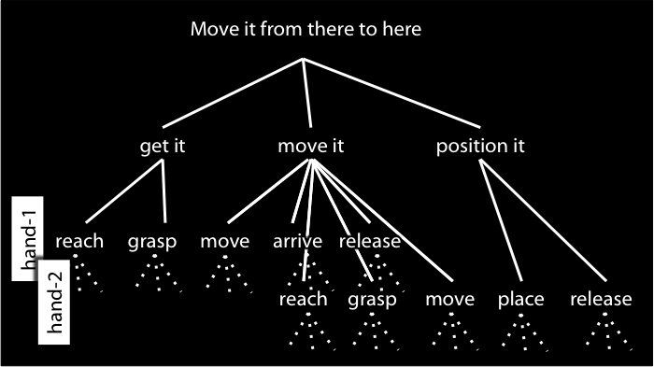
Do that
=
?
Notes:
But we can’t point to motor representations like we can point to maps!
What we need for reference by deference to a motor representation is experience of motor action.
And if you think about motor imagination it seems quite plausible that we do have such experiences.
So here’s the thought:
There are no direct inferential connections between intentions and motor representations.
Harmony is ensured by the fact that where an intention involves a bodily movement, either executing that intention involves forming a further intention or else the intention involves a demonstrative that refers to an action by deferring to a motor representation.
So what connects intentions to motor representations---what connects the reflective to the pre-reflective---is the use of demonstratives, and this depends on experience of motor action.
Much as on some views all thought about objects ultimately depends on perceptual experience (e.g. Campbell 2002), so also intending bodily actions may ultimately depend on motor experience.
Experience anchors the reflective in the pre-reflective.

Slide 114
Notes:
So what is intention!? Element of a plan. Sui generis mental state. Role defined by agglomeration among other norms

Slide 115
first round
A (10)
B (5)
second round
C (10)
D (5)
E (55)

Slide 116
first round
A (10)
B (5)
second round
C (10)
D (5)
E (55)

Slide 117
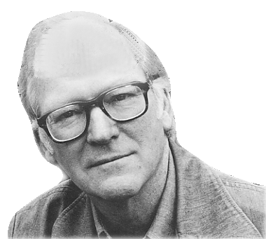
“What events in the life of a person reveal agency; what are his deeds and his doings in contrast to mere happenings in his history; what is the mark that distinguishes his actions?”

Slide 118
“What events in the life of a person reveal agency; what are his deeds and his doings in contrast to mere happenings in his history; what is the mark that distinguishes his actions?”
agent
event
R
intention

Slide 119
“What events in the life of a person reveal agency; what are his deeds and his doings in contrast to mere happenings in his history; what is the mark that distinguishes his actions?”
“a person is the agent of an event if and only if there is a description of what he did that makes true a sentence that says he did it intentionally”
(Davidson 1971: 46)

Slide 120
first round
A (10)
B (5)
second round
C (10)
D (5)
E (55)
F (5)

Slide 121
One night in Budapest
[A] My having dinner at ___ would be desirable.
[B] My visiting the theatre would be desirable.
[C] My shopping at ___ would be desirable.
Notes:
A simpler case : no individual thing excludes any other, but not all three can be realised
each thing is individually desirable, exactly how desirable depends on what other thing it is done with;
the agent doesn’t know exactly what would be most desirable (so the fact that [A] excludes [B]&[C] does not prevent the all things considered judgment in favour of [A]);
[***I’m worried this won’t work unless it reduces to a Buridan problem.]

Slide 122
One night in Budapest
[A] My having dinner at ___ would be desirable.
[B] My visiting the theatre would be desirable.
[C] My shopping at ___ would be desirable.
Alternative frame
[A] & [B]
[A] & [C]
[B] & [C]
Notes:
A simpler case : each is desirable; no individual thing excludes any other; but not all three can be realised

